Slide 1


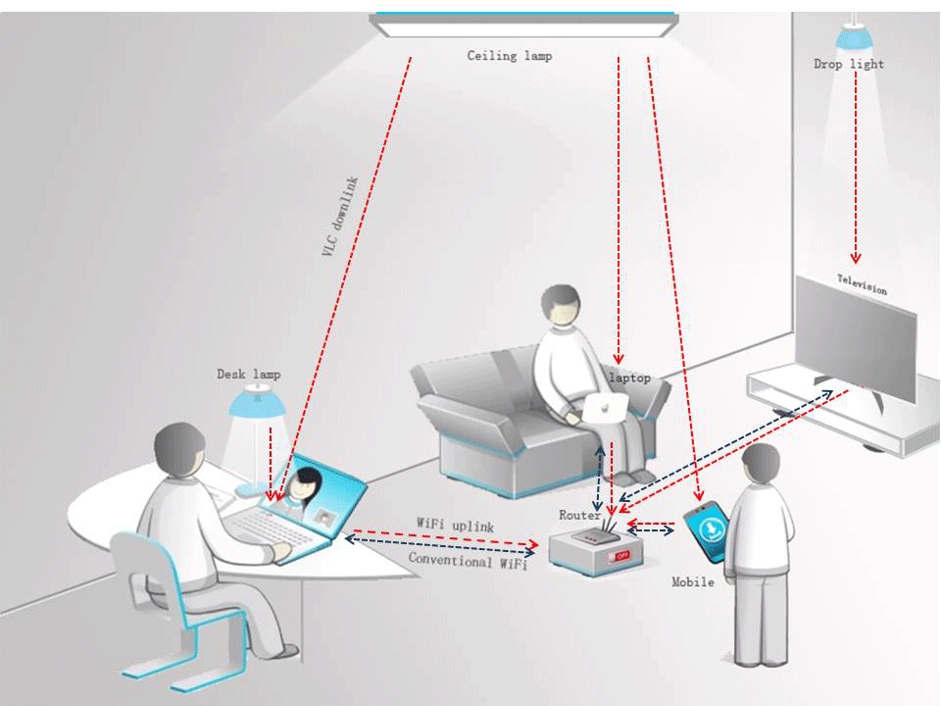
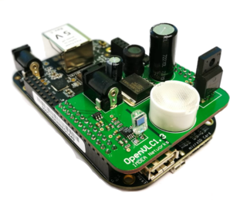
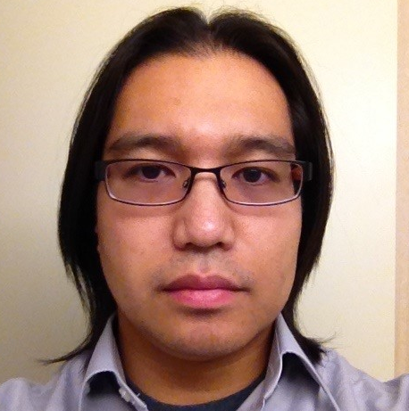

Li-Fi Communication
ECE 403 Senior Design
Sacdiya Sayid (EL)
Nelson Caberto (TL)
Visible Light Wi-Fi: Li-Fi uses visible light to transmit data between devices. Li-Fi is an emerging technology for indoor communication.
Greg Graham (IM)

Slide 2
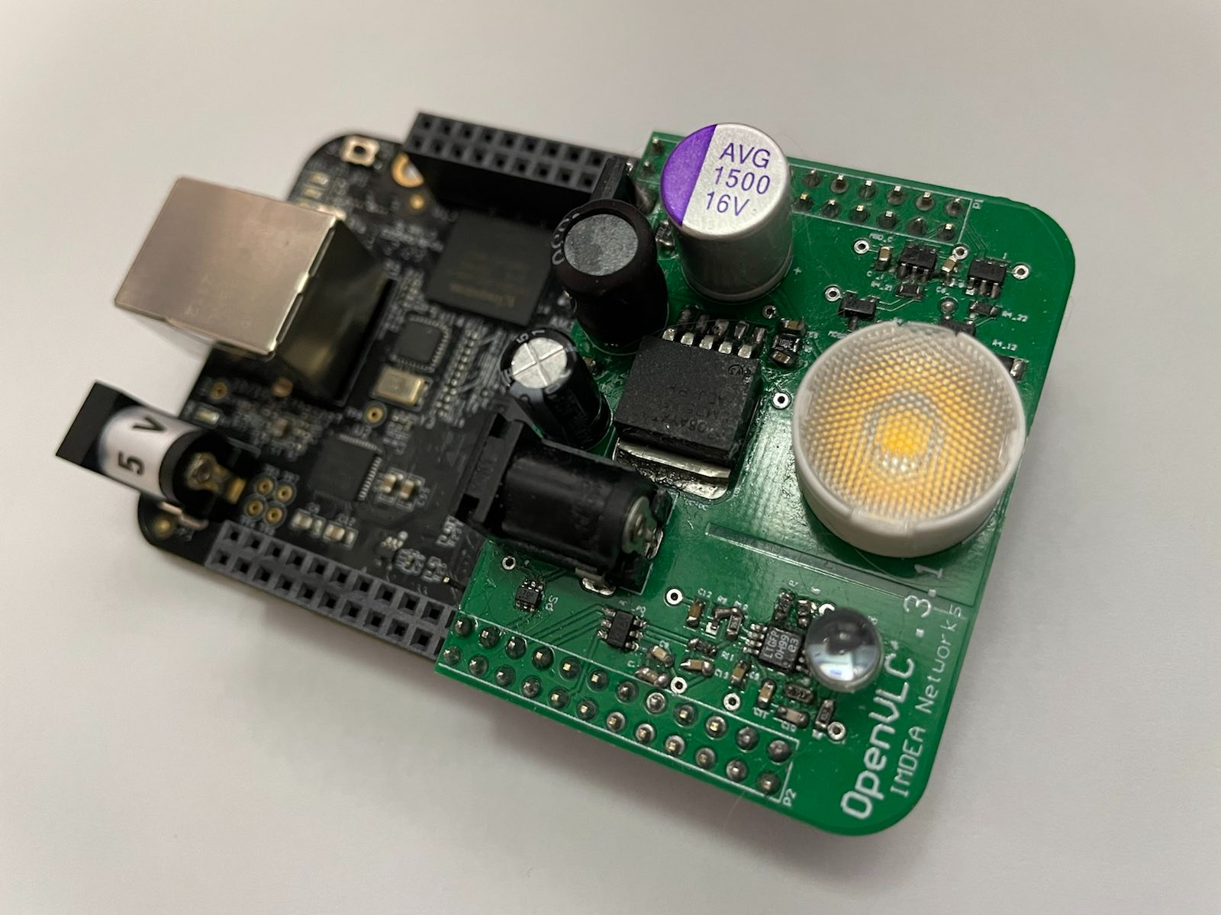
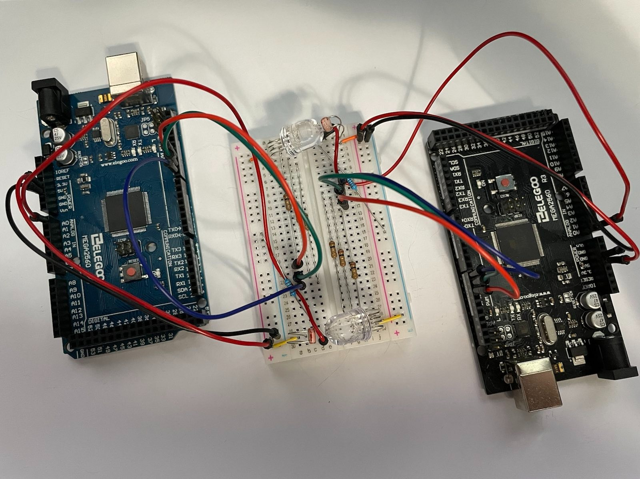
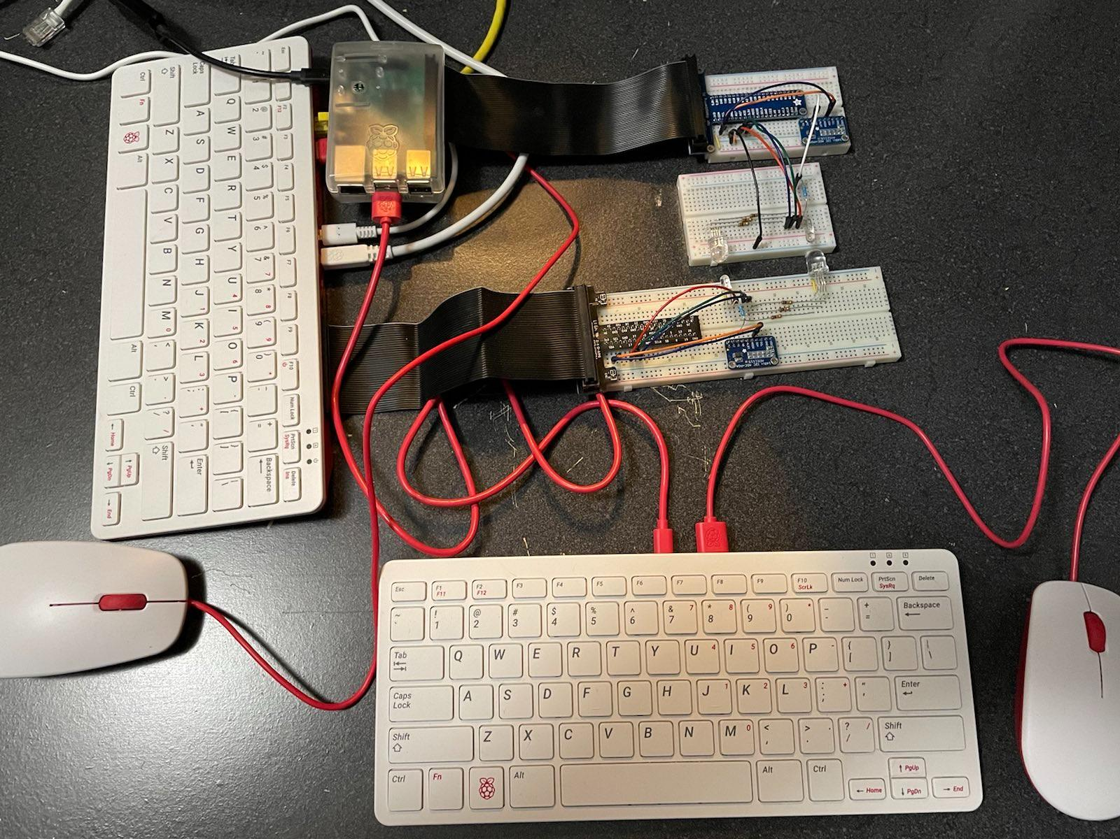
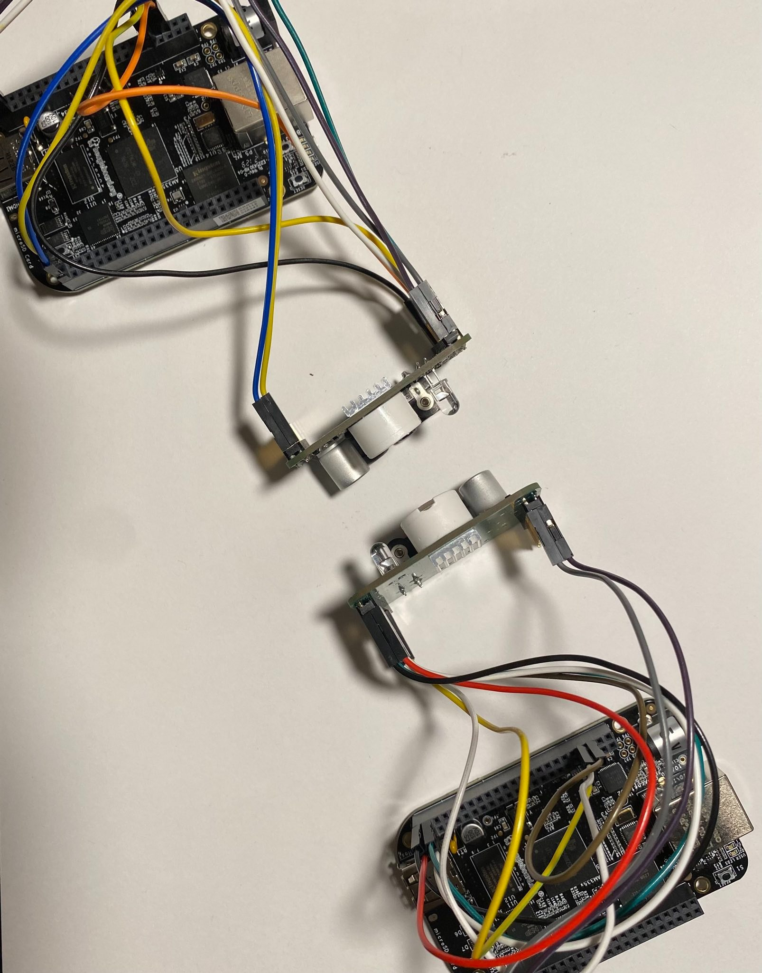
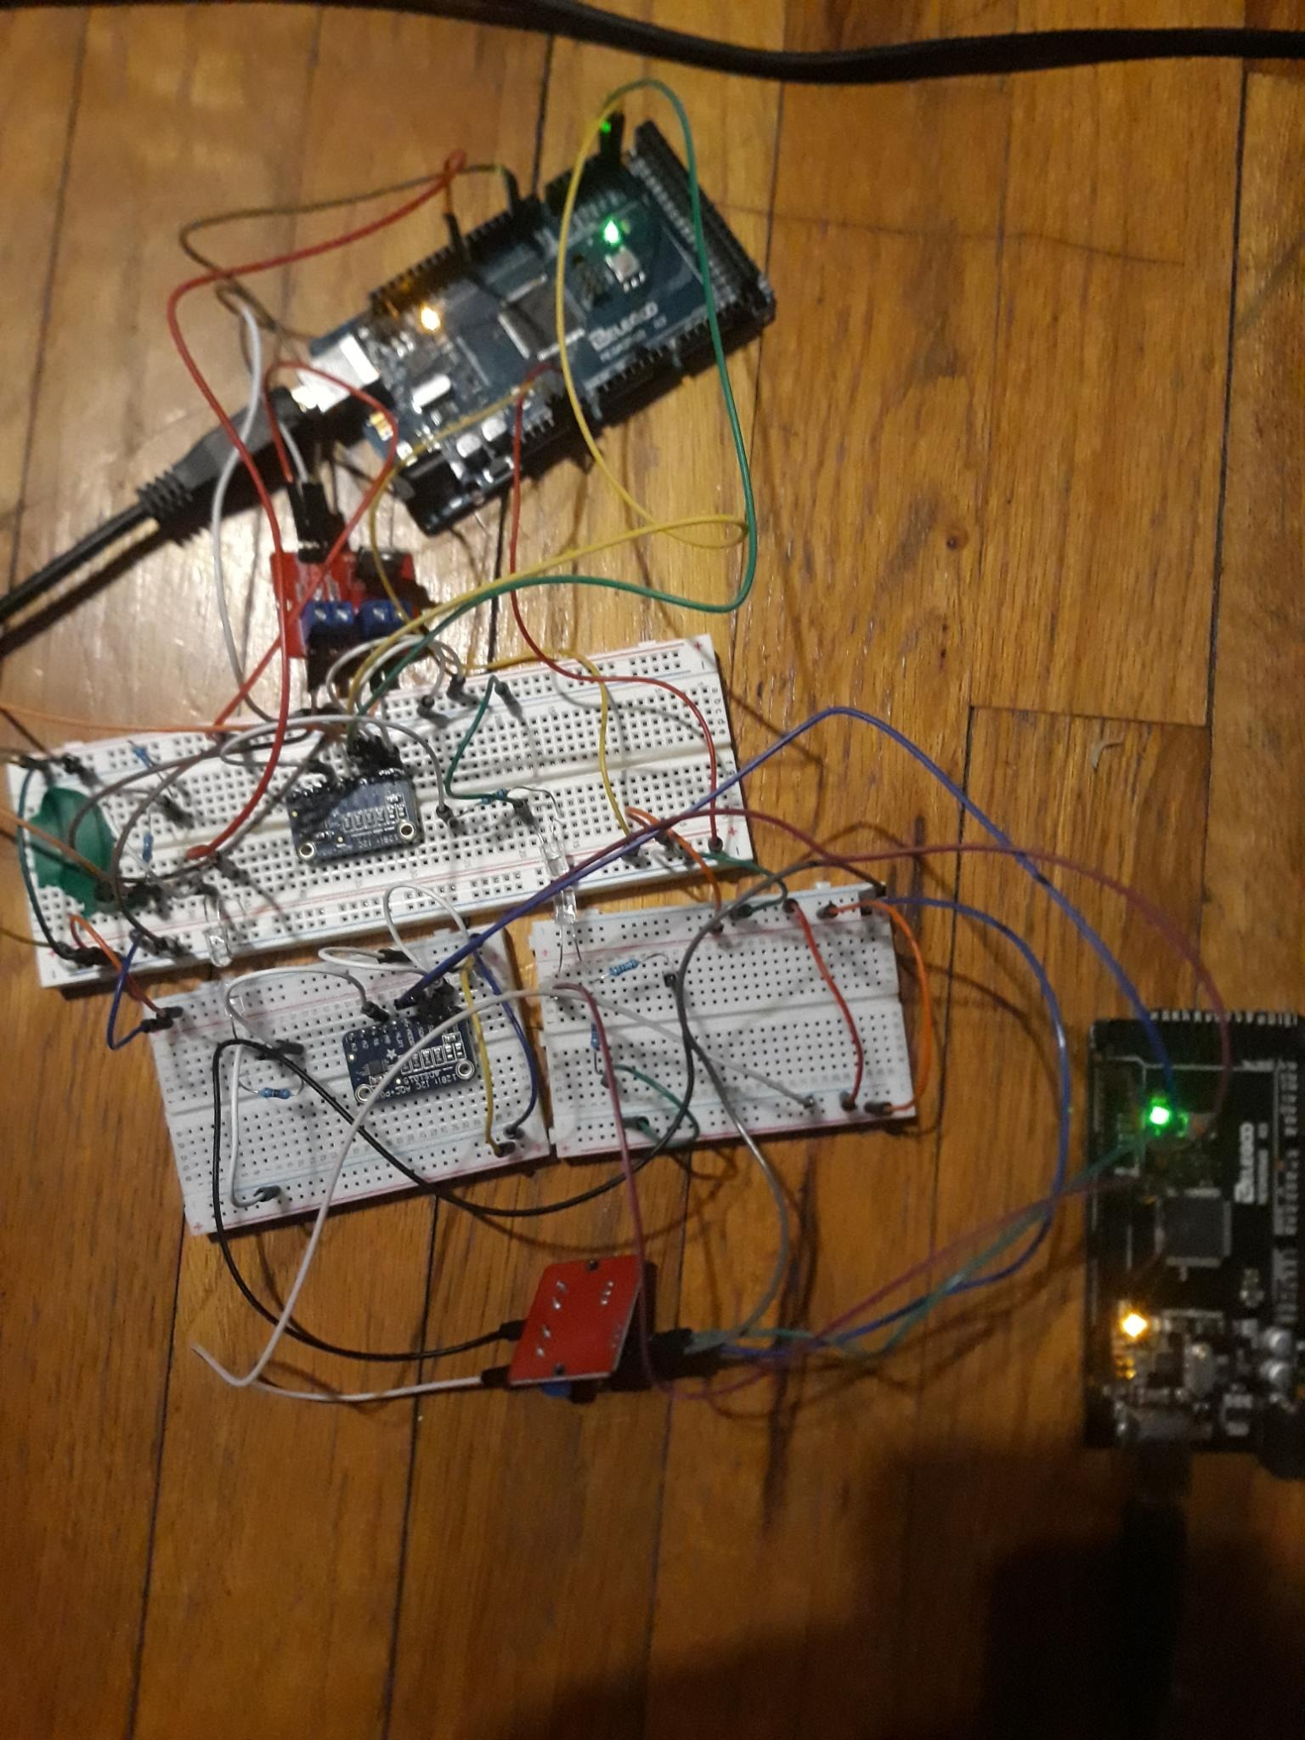
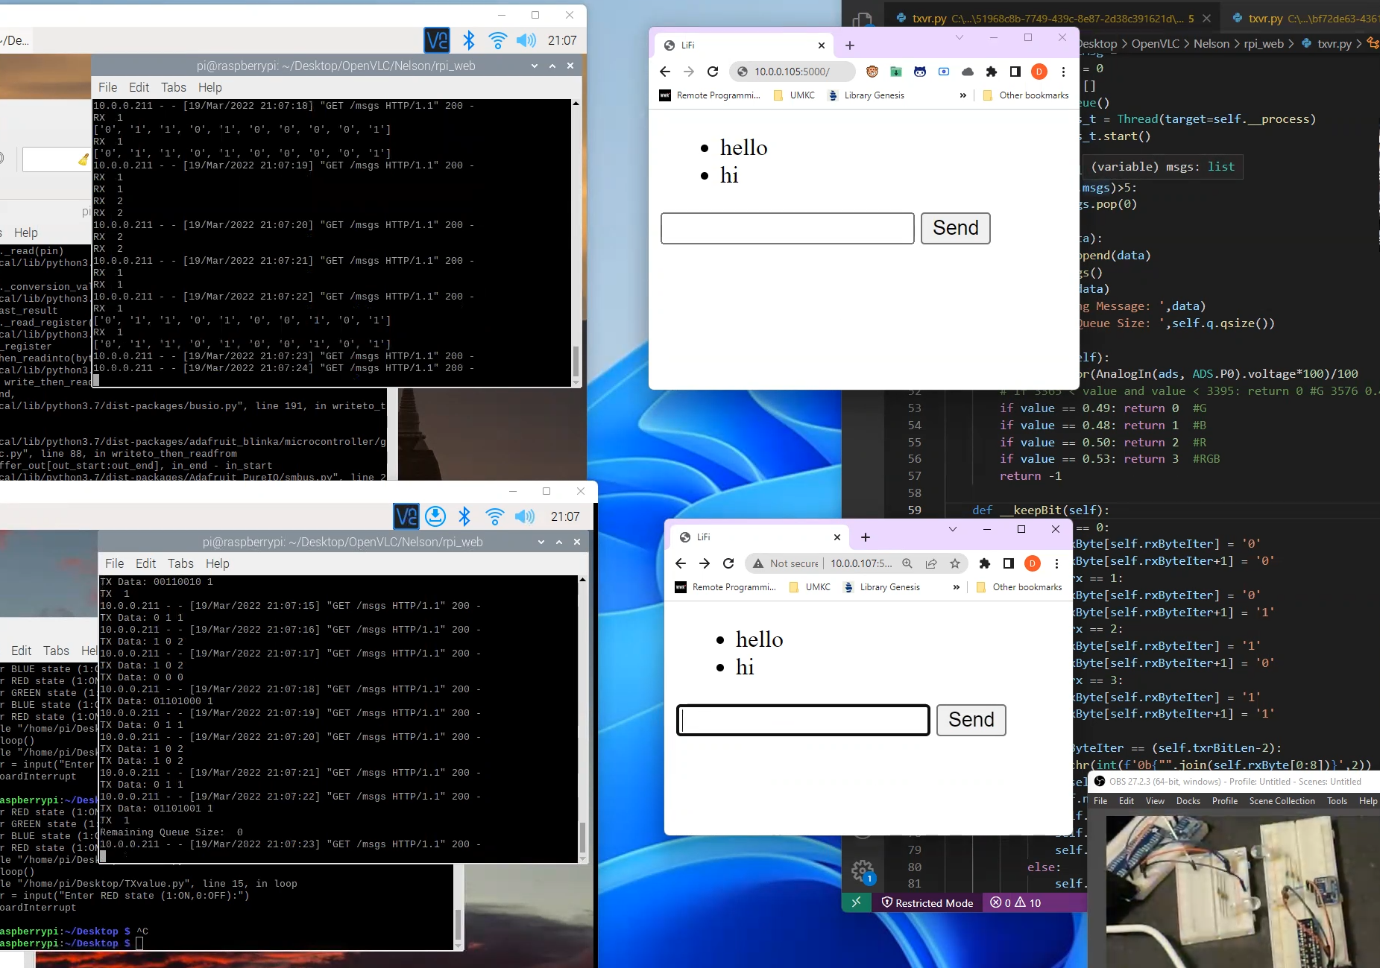
Prototype
Failed Fabrication
From Scratch
Port to RPi
1
3
5
Troubleshooting
Add MOSFET and ADC
Web Interface
2
4
6

Slide 3
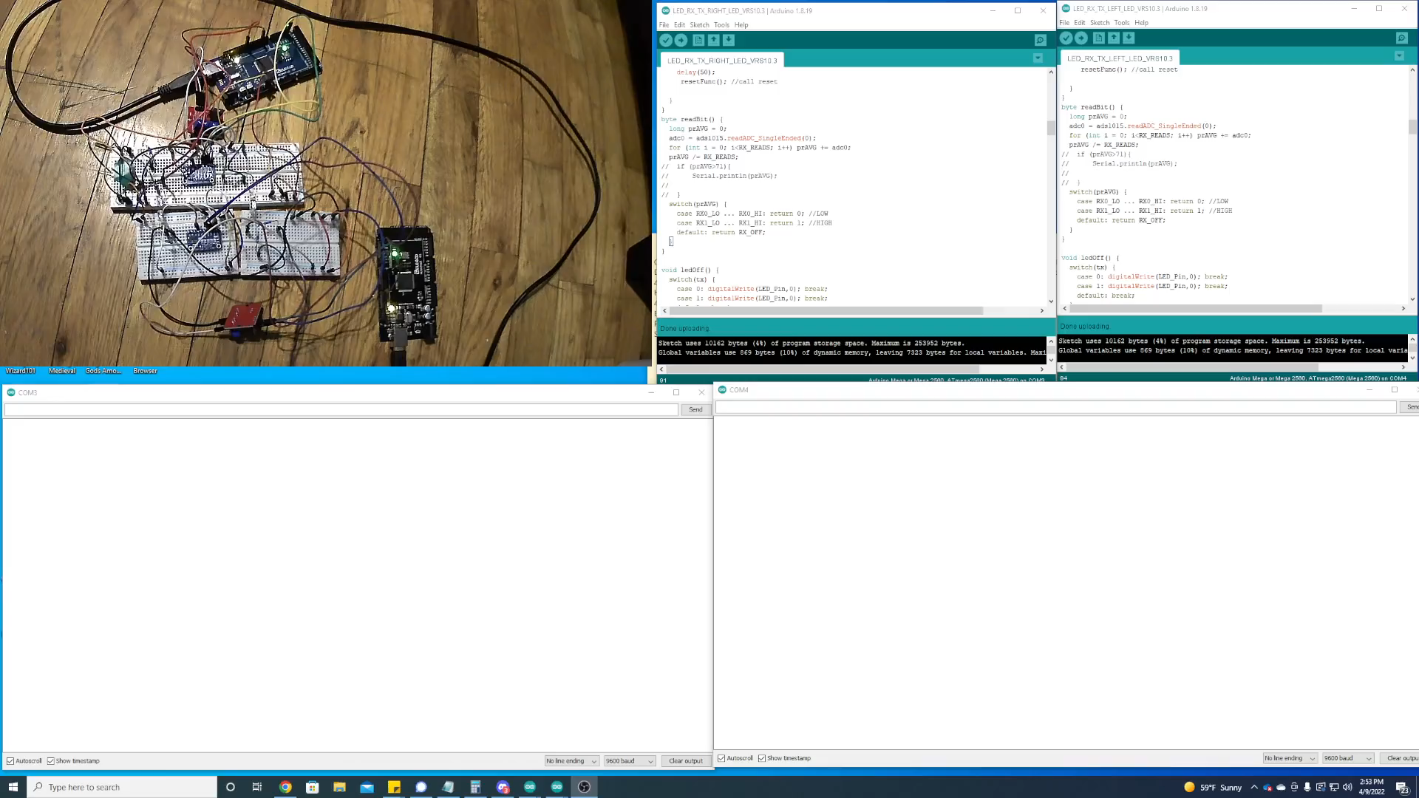
Demo of Arduino-With Acknowledgment

Slide 4
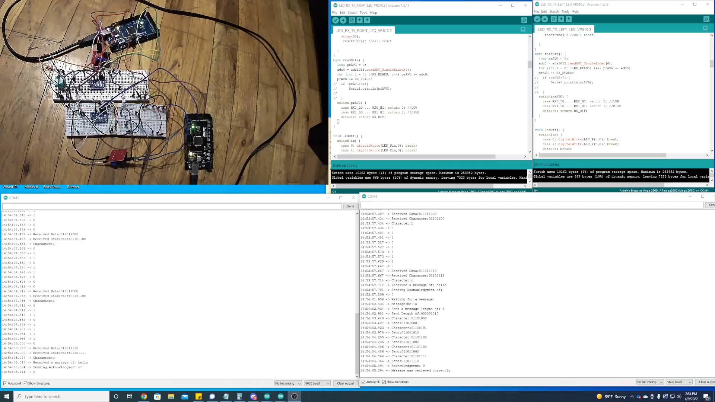
Demo of Arduino-With Timeout

Slide 5

Demo of RPI

Slide 6
Test Methodology
Stage | Step | Test
PCB Fabrication | Soldering | Component Continuity with Pads and Traces
 | Unit | Power on Run Drivers
Design Circuit | Lamp | Powers on and off with Code
 | PhotoResistor | Detects Light Levels with Code
Design Logic | Lamp On Send Delay | Tune delay for success rate
 | Lamp Off Wait Delay | Tune delay for success rate
 | PhotoResistor Read Tries | Tune tries for reliable read
Bit | Send Bit | Reliably send a bit
 | Receive Bit | Reliably recive a bit
 | Tune Delays | Reduce delays to not affect reliability
Byte | Send Byte | Reliably send a byte
 | Recive Byte | Reliably recive a byte
 | Incomplete Byte Timeout | Reset and Fail Recive if incomplete
 | Parity Bit | Intentionally Fail a transmission to see if the parity bit check works
 | Tune Delays | Reduce delays to not affect reliability
String | Send String | Reliably send a string
 | Receive String | Reliably recive a string
 | Tune Delays | Reduce delays to not affect reliability
Port to RPi | C++ to Python | Verify all functionality
 | Upgrade to ADC and PhotoDiode | Augment code and ensure previous functionality works
 | Tune Delays | Reduce delays to not affect reliability
Arduino | Upgrade to ADC | Augment code and ensure previous functionality works
 | Upgrade to MOSFETs | Augment code and ensure previous functionality works
 | Tune Delays | Reduce delays to not affect reliability
Rpi Web Server | Flask | Create and Verify Routes
 | HTML | Create and Verify Web Interface
 | JavaScript | Verify Communication with Web Server and Browser
 | MultiThreaded Queue | Make sure server and browser are non blocking
 | Send Message | Verify Browser to OpenVLC communcations
 | Receive Message | Verify OpenVLC to Browser communications

Slide 7
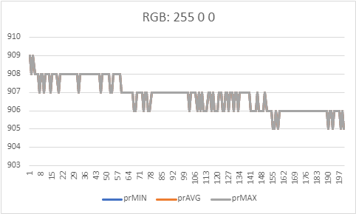
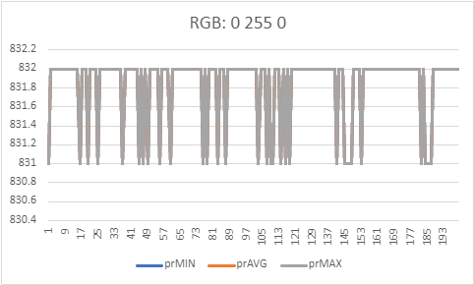
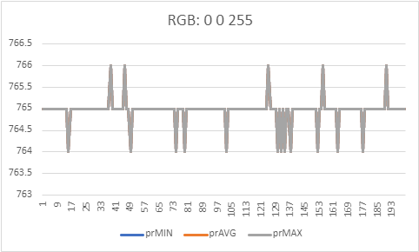
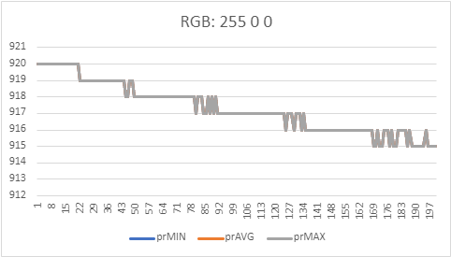
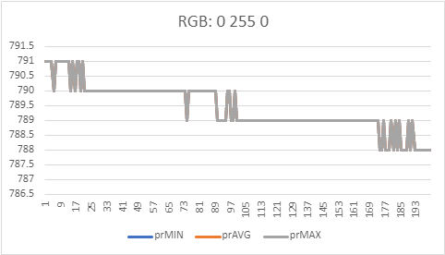
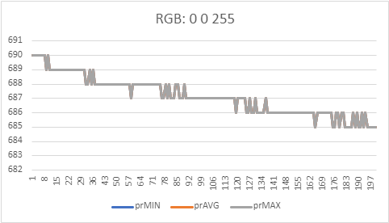
Test Results (20 points)
RGB Sample 1
RGB Sample 2

Slide 8
Test Results
Notes:
Greg’s initial distance tests using one brightness level at max from half an inch away to one and a half feet away shows that we will need to use an OP AMP for any distance past point blank range.

Slide 9
Reliability Analysis (10 points)
Have you analyzed possible failure conditions for your project? What can trigger your robot/system to malfunction? What data you have to justify your assumption?
Stage | Step | Test | Failure Point
PCB Fabrication | Soldering | Component Continuity with Pads and Traces | Component could be bad
 | Unit | Power on Run Drivers | Drivers could be incompatible with lastest operating system
Design Circuit | Lamp | Powers on and off with Code | Brightness levels between lamps are not the same
 | PhotoResistor | Detects Light Levels with Code
Design Logic | Lamp On Send Delay | Tune delay for success rate
 | Lamp Off Wait Delay | Tune delay for success rate
 | PhotoResistor Read Tries | Tune tries for reliable read | Read widly varies because of PWM signal for varying lamp brightness
Bit | Send Bit | Reliably send a bit | May not send, or may send when reciver is not ready
 | Receive Bit | Reliably recive a bit | May not receive, or recieves from unintended source
 | Tune Delays | Reduce delays to not affect reliability
Byte | Send Byte | Reliably send a byte | Timing could be off when sending and reciever not ready to receive
 | Recive Byte | Reliably recive a byte | May not receive all bits
 | Incomplete Byte Timeout | Reset and Fail Recive if incomplete | Could timeout early or not at all
 | Tune Delays | Reduce delays to not affect reliability
String | Send String | Reliably send a string
 | Receive String | Reliably recive a string | May not receive all bytes
Notes:
Generally, the transmission must be perfect else we will fail and we only have one instance with acknowledgements to resend the entire transmission if it fails. We did not record data to justify our assumption, we have errors that pop up and we adjust our delays to minimize those transmit/receive errors.

Slide 10
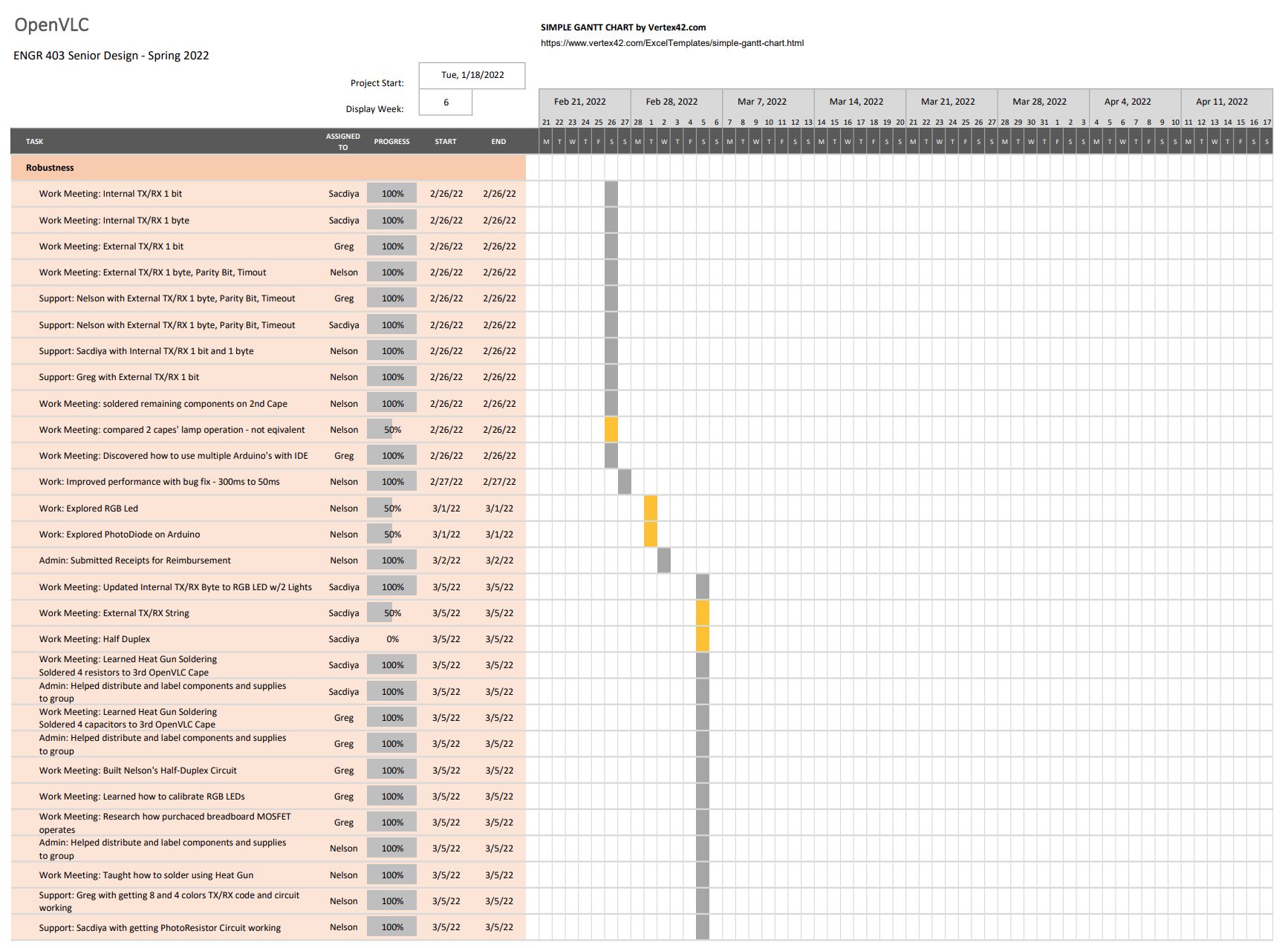

Slide 11
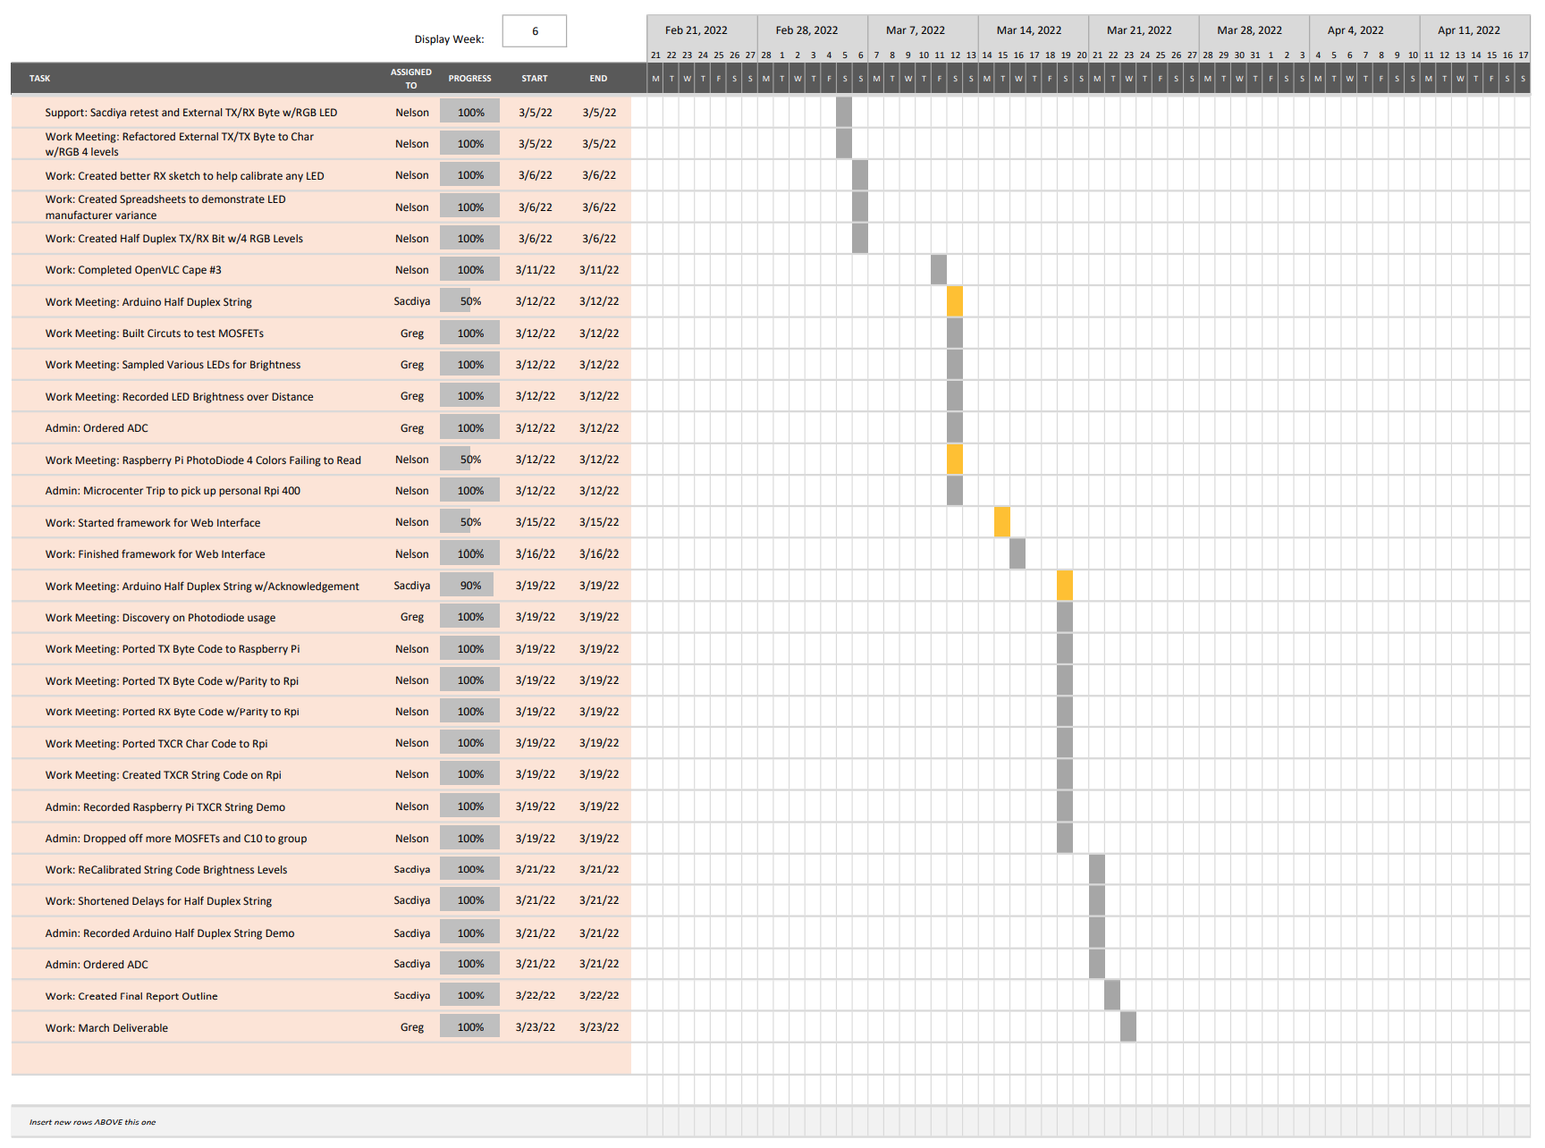

Slide 12
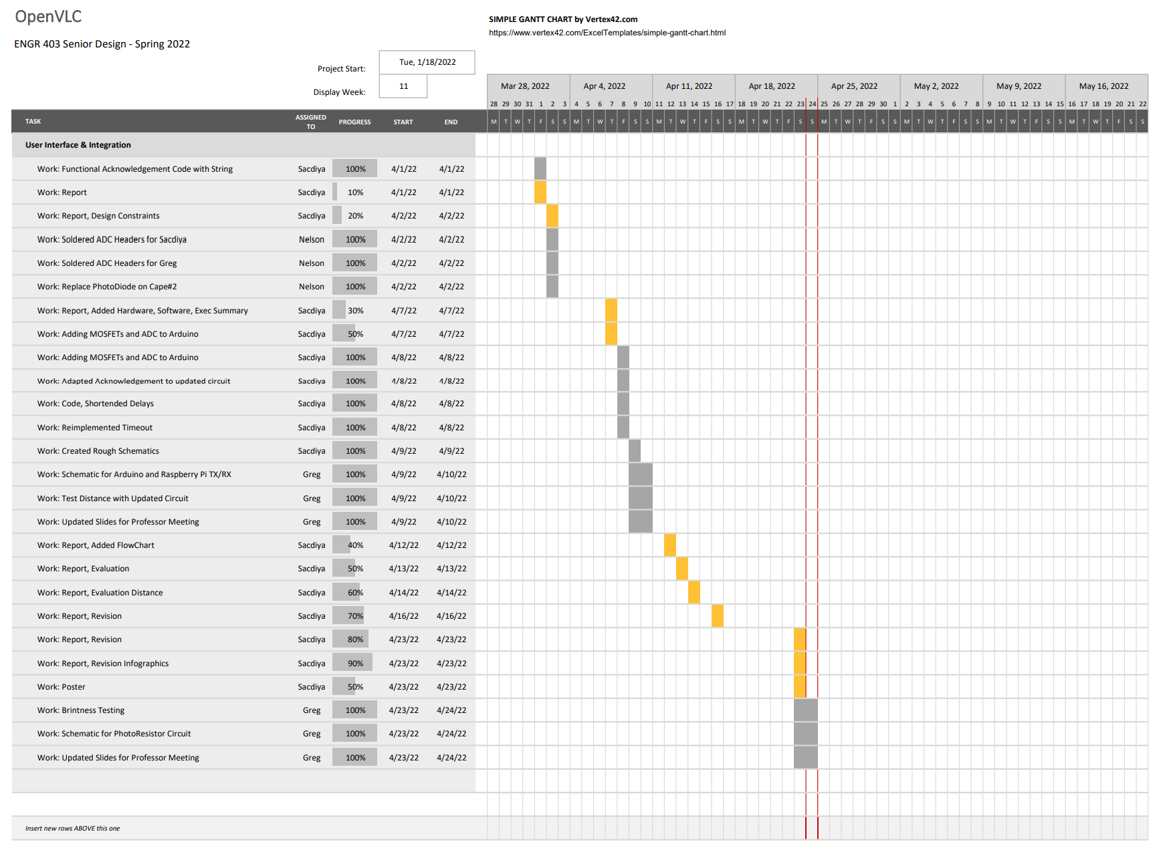

Slide 13
Attendance
Anyone absent during the required meetings will see 10 points deducted.

